Slide 1
Library Structure 3
Presented by Hua Bai
Original Slides by Andrew Leaver-Fay
Aug 30th, 2016
https://www.youtube.com/watch?v=ypii1RsIZzA
https://www.youtube.com/watch?v=9vYk1b3X4Ug

Slide 2
Libraries
Libraries
"core"
"protocols"
ObjexxFCL
utility
core.1
p1
numeric
core.2
p2a
p2b
basic
core.3
p3
"core"
core.4
p4a
p4b
p4c
p4d
p4e
p4f
p4g
p4h
core.5
p5a
p5b
p5c
p5d
p5e
p5f
"protocols"
p6
devel
p7

Slide 3
clang++ -o build/src/debug/macos/10.10/64/x86/clang/7.0/default/apps/pilot/huabaiuw/split_pose_directly.o -c -isystem external/boost_1_55_0/ -isystem external/ -isystem external/include/ -isystem external/dbio/ -std=c++11 -march=core2 -mtune=generic -pipe -Qunused-arguments -DUNUSUAL_ALLOCATOR_DECLARATION -ftemplate-depth-256 -stdlib=libstdc++ -W -Wall -Wextra -pedantic -Werror -Wno-long-long -Wno-strict-aliasing -march=native -mtune=native -stdlib=libc++ -Wno-unused-variable -O0 -g -DBOOST_ERROR_CODE_HEADER_ONLY -DBOOST_SYSTEM_NO_DEPRECATED -DBOOST_MATH_NO_LONG_DOUBLE_MATH_FUNCTIONS -DCXX11 -DPTR_STD -Isrc -Iexternal/include -Isrc/platform/macos/64/clang/7.0 -Isrc/platform/macos/64/clang -Isrc/platform/macos/64 -Isrc/platform/macos -Iexternal/boost_1_55_0 -Iexternal/libxml2/include -Iexternal -Iexternal/dbio -I/usr/include -I/ usr/local/include src/apps/pilot/huabaiuw/split_pose_directly.cc
clang++ -o build/src/debug/macos/10.10/64/x86/clang/7.0/default/split_pose_directly.default.macosclangdebug -stdlib=libc++ build/src/debug/macos/10.10/64/x86/clang/7.0/default/apps/pilot/huabaiuw/split_pose_directly.o -Lexternal/lib -Lbuild/src/debug/macos/10.10/64/x86/clang/7.0/default -Lsrc -Lbuild/external/debug/macos/10.10/64/x86/clang/7. 0/default -Lexternal -L/usr/lib -ldevel -lprotocols.7 -lprotocols.6 -lprotocols_e.5 -lprotocols_d.5 -lprotocols_c.5 -lprotocols_b.5 -lprotocols_a. 5 -lprotocols_h.4 -lprotocols_g.4 -lprotocols_f.4 -lprotocols_e.4 -lprotocols_d.4 -lprotocols_c.4 -lprotocols_b.4 -lprotocols_a.4 -lprotocols.3 - lprotocols_b.2 -lprotocols_a.2 -lprotocols.1 -lcore.5 -lcore.4 -lcore.3 -lcore.2 -lcore.1 -lbasic -lnumeric -lutility -lObjexxFCL -lz -lcppdb -lsqlite3 -lz -lcppdb -lsqlite3 -lcifparse -lxml2

Slide 4
Libraries
Libraries
"core"
"protocols"
ObjexxFCL
utility
core.1
p1
numeric
core.2
p2a
p2b
basic
core.3
p3
"core"
core.4
p4a
p4b
p4c
p4d
p4e
p4f
p4g
p4h
core.5
p5a
p5b
p5c
p5d
p5e
p5f
"protocols"
p6
devel
p7

Slide 5
Rosetta/main/source/src/
ObjexxFCL.src.settings
apps.src.settings
basic.src.settings
core.1.src.settings
core.2.src.settings
core.3.src.settings
core.4.src.settings
core.5.src.settings
devel.src.settings
devel.src.settings.release
devel.src.settings.template
numeric.src.settings
pilot_apps.src.settings
pilot_apps.src.settings.all
pilot_apps.src.settings.release
pilot_apps.src.settings.template
utility.src.settings
protocols.1.src.settings
protocols.3.src.settings
protocols.6.src.settings
protocols.7.src.settings
protocols_a.2.src.settings
protocols_a.4.src.settings
protocols_a.5.src.settings
protocols_b.2.src.settings
protocols_b.4.src.settings
protocols_b.5.src.settings
protocols_c.4.src.settings
protocols_c.5.src.settings
protocols_d.4.src.settings
protocols_d.5.src.settings
protocols_e.4.src.settings
protocols_e.5.src.settings
protocols_f.4.src.settings
protocols_g.4.src.settings
protocols_h.4.src.settings

Slide 6
Libraries
https://www.rosettacommons.org/manuals/archive/rosetta_2016.02.58402_user_guide/core+protocols/dir_aebb8dcc11953d78e620bbef0b9e2183.html
Libraries
"core"
"protocols"
ObjexxFCL
utility
core.1
p1
numeric
core.2
p2a
p2b
basic
core.3
p3
"core"
core.4
p4a
p4b
p4c
p4d
p4e
p4f
p4g
p4h
core.5
p5a
p5b
p5c
p5d
p5e
p5f
"protocols"
p6
devel
p7

Slide 7
Outline: core.3
Highlights:
core/pose
Pose
core/scoring
ScoreFunction
Energies
EnergyGraph
LREnergyContainer
core/scoring/methods
EnergyMethod heirarchy
Also of interest:
core/pose/symmetry
util
core/scoring/symmetry
SymmetricScoreFunction
SymmetricEnergies
core/scoring/etable/
Etable
EtableEnergy
count_pair/CountPairFunction.hh
count_pair/atom_pair_energy_inline.hh
core/scoring/hbonds
HBondSet
core/select/residue_selector/
ResidueSelector.hh

Slide 8
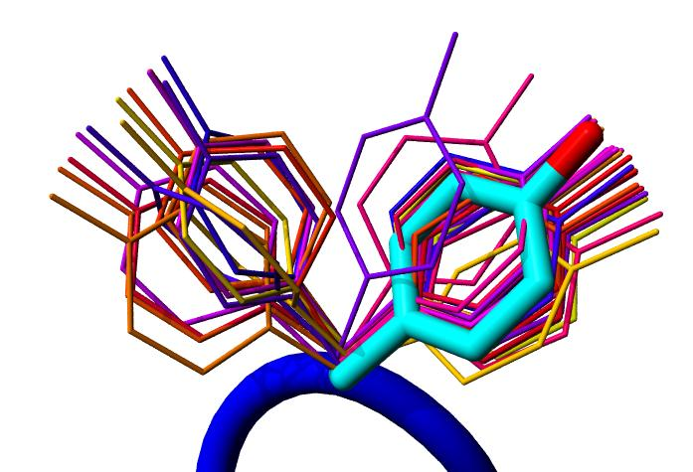
Outline: core.4
pack/
task/
PackerTask.hh
operation/
TaskOperation.hh
optimization/
AtomTreeMinimizer.hh
CartesianMinimizer.hh
core::pack::task::PackerTaskOP repack_task = core::pack::task::TaskFactory::create_packer_task (*mypose);
repack_task->restrict_to_repacking();
core::pack::pack_rotamers( *mypose, *sfxn, repack_task );
core::optimization::MinimizerOptions min_opts( "lbfgs_armijo_atol", 0.01, true); core::optimization::AtomTreeMinimizer atm;

Slide 9
Outline: core.5
import_pose/
import_pose.hh
core::pose::PoseOP mypose = core::import_pose::pose_from_file( filenames[1] );
#include <core/import_pose/import_pose.hh>

Slide 10
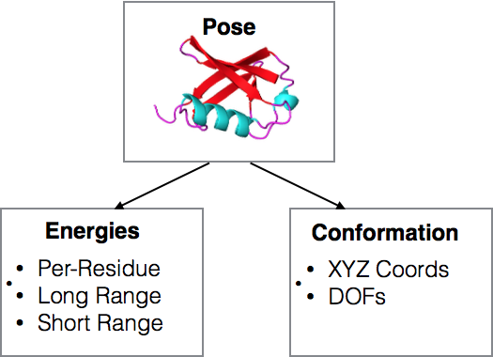
core.3
namespace core {
namespace pose {
class Pose {
public:
...
private:
conformation::ConformationOP conformation_;
scoring::EnergiesOP energies_;
};

Slide 11
core.3
Pose manages the shuttling of information between the Conformation and the Energies objects
During scoring, Pose requests from the Conformation object "what has changed since the last time you were scored" and gives that information to the Energies object.
namespace core {
namespace pose {
class Pose {
public:
...
private:
conformation::ConformationOP conformation_;
scoring::EnergiesOP energies_;
};

Slide 12
core.3
namespace core {
namespace pose {
class Pose {
public:
...
private:
conformation::ConformationOP conformation_;
scoring::EnergiesOP energies_;
scoring::constraints::ConstraintSetOP constraints_;
};
Pose also stores a ConstraintSet
(Constraints are very useful and are commonly used in many protocols)

Slide 13
core.3
namespace core {
namespace pose {
class Pose {
public:
...
private:
conformation::ConformationOP conformation_;
scoring::EnergiesOP energies_;
scoring::constraints::ConstraintSetOP constraints_;
basic::datacache::BasicDataCacheOP data_cache_;
};
Pose holds a data_cache_ object to store arbitrary data * Data must be derived from basic::datacache:: CacheableData * Held in owning_ptr O(1) access -- it’s an array!
* uses the enumeration in
pose/datacache/ CacheableDataType.hh
Cloned in every Pose copy operation.

Slide 14
????
ScoreFunction
Energies
ScoreType
EnergyMap
EnergyGraph (EnergyEdge, EnergyNode)
EnergyMethods
Etables
……
https://www.rosettacommons.org/demos/latest/tutorials/scoring/scoring

Slide 15
core.3
namespace core {
namespace scoring {
enum ScoreType {
fa_atr = 1,
fa_rep,
fa_sol,
...
n_score_types
};
namespace core {
namespace scoring {
class EnergyMap {
public:
...
private:
Real map_[ n_score_types ];
};
Rosetta/main/source/src/core/scoring/ScoreType.hh
What is enum?

Slide 16
core.3
namespace core {
namespace scoring {
class Energies {
public:
...
private:
utility::vector1< EnergyMap > onebody_energies_;
EnergyGraph energy_graph_;
};
onebody_energies_ holds for each residue the intra-residue energies
energy_graph_ holds for each interacting residue pair the inter-residue energies
One-bogy energy examples:
fa_intra_rep Lennard-Jones repulsive between atoms in the same residueamino acid terms.
rama Ramachandran preferences.
fa_dun Internal energy of sidechain rotamers as derived from Dunbrack's statistics.
omega Omega dihedral in the backbone. A Harmonic constraint on planarity with standard deviation of ~6 deg.
ref Reference energy for each amino acid. Balances internal energy of amino acid terms.
Two-bogy energy examples:
fa_atr Lennard-Jones attractive between atoms in different residues
fa_rep Lennard-Jones repulsive between atoms in different residues
fa_elec Coulombic electrostatic potential with a distance-dependent dielectric

Slide 17
core.3
namespace core {
namespace scoring {
class EnergyGraph : public graph::Graph {
public:
...
private:
boost::unordered_object_pool< EnergyEdge > edge_pool_;
graph::ArrayPool< Real > energy_array_pool_;
utility::vector1< int > score_type_to_active_;
};
class EnergyEdge : public graph::Edge {
public:
...
private:
graph::ArrayPoolElement< Real > array_;
};
Allocating and deallocating eges with new and delete is slow; so instead, allocate a large block of edges and manage the blocks
We have hundreds of score terms, but rarely are they all used at the same time.
If each edge contained an EnergyMap, too much memory would be wasted on storing 0's for terms not being used.
ArrayPool allocates a pool of arrays of a single size and is is managed by the EnergyGraph

Slide 18
core.3
namespace core {
namespace scoring {
class EnergyEdge : public graph::Edge {
public:
...
Real operator [] ( ScoreType st ) const {
int aid = get_energy_owner()->score_type_2_active()[ st ];
if ( aid >= 0 ) {
return array_[ aid ];
} else {
return 0;
}
}
private:
graph::ArrayPoolElement< Real > array_;
};

Slide 19
core.3
namespace core {
namespace scoring {
class ScoreFunction : public utility::pointer::ReferenceCount {
public:
...
private:
EnergyMap weights_;
...
CI_2B_Methods ci_2b_methods_;
CD_2B_Methods cd_2b_methods_;
CI_1B_Methods ci_1b_methods_;
CD_1B_Methods cd_1b_methods_;
CI_LR_2B_Methods ci_lr_2b_methods_;
CD_LR_2B_Methods cd_lr_2b_methods_;
LR_2B_Methods lr_2b_methods_;
WS_Methods ws_methods_;

Slide 20
core.3
namespace core {
namespace scoring {
namespace methods {
class EnergyMethod {...};
class OneBodyEnergy : public EnergyMethod {...};
class TwoBodyEnergy : public EnergyMethod {...};
class WholeStructureEnergy : public EnergyMethod {...};

Slide 21
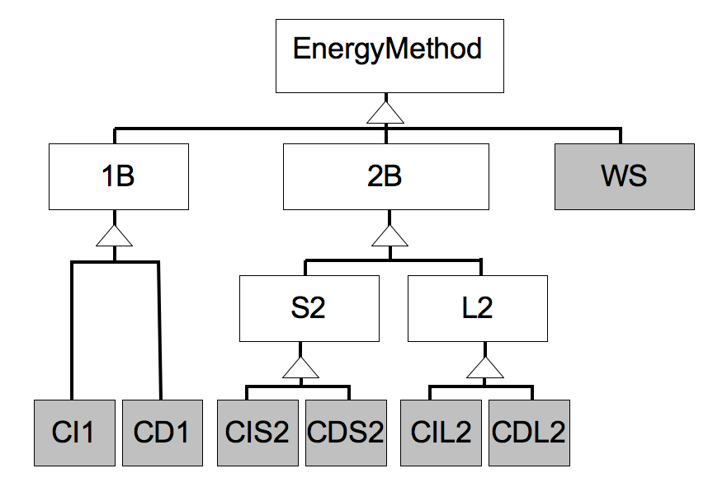
core.3
Context dependent:
The energy for a residue or a pair of
residues depends on the conformation
of surrounding residues.
E.g. the strength of a hydrogen bond
between residues i and j depends on
the number of neighbors each residue
has.
Context independent:
The energy for a residue or a residue pair
does not at all depend on the surroundings
E.g. the Lennard-Jones energy

Slide 22
core.3
Two body energies:
Short range two body energies:
there is some distance cutoff, d, s.t. if all
heavy atoms on i are further than d away
from all heavy atoms on j then the energy
between i and j is zero.
Long range two body energies:
there is no such cutoff

Slide 23
core.3
Two body energies:
Short range two body energies:
store interaction energies in the
EnergyGraph
Are not responsible for determining which
residues to evaluate energies between
Long range two body energies:
Provide their own containers in which to
store the energies they calculate that
tell the ScoreFunction (and anyone else)
which residue pairs have non-zero
interaction energies.

Slide 24
core.3
Two body energies:
void
residue_pair_energy(
pose::Pose const & pose,
ScoreFunction const & sfxn,
conformation::Residue const & r1,
conformation::Residue const & r2,
EnergyMap & emap
) const;

Slide 25
core.3
namespace core {
namespace scoring {
class ScoreFunction : public utility::pointer::ReferenceCount {
public:
...
private:
EnergyMap weights_;
...
CI_2B_Methods ci_2b_methods_;
CD_2B_Methods cd_2b_methods_;
CI_1B_Methods ci_1b_methods_;
CD_1B_Methods cd_1b_methods_;
CI_LR_2B_Methods ci_lr_2b_methods_;
CD_LR_2B_Methods cd_lr_2b_methods_;
LR_2B_Methods lr_2b_methods_;
WS_Methods ws_methods_;

Slide 26
core.3
ScoreFunction
EnergyMethod consumer #1
Algorithm is somewhat complicated
Has not changed since 2007
https://www.rosettacommons.org/docs/latest/development_documentation/tutorials/new-energy-method

Slide 27
core.3
(Re)scoring a pose:
Drop edges from the EnergyGraph between residue pairs that have moved wrt each other (i.e. that have different colors in the "domain map")
Detect which pairs of residues are near each other using a "point graph." Each node in this graph represents an xyz point; edges are added between every pair of residues w/i a cutoff threshold.
Iterate across the point graph:
If edge (i,j) connects two residues with different colors, and
if the residues i and j are within an interaction cutoff, and
if neither residue is a virtual residue, then
Add edge (i,j) to the EnergyGraph
https://www.rosettacommons.org/docs/latest/rosetta_basics/scoring/scoring-explained

Slide 28
core.3
(Re)scoring a pose (cont)
...
...
...
Iterate across the energy graph:
score the context-dependent two-body energies
if edge (i,j) connects two residues with different colors, then score the context-independent two-body energies
Store the residue pair energies on the edge
Iterate across all residues:
score the context-dependent one-body energies
if the residue has had internal-DOF changes, score the context-independent one-body energies
Iterate across all the long range two-body energies and their respective LREnergyContainers
score each residue pair if (cont-dep || moved(i,j) )
Evaluate whole-structure energies

Slide 29
Outline: core.4
pack/
task/
PackerTask.hh
operation/
TaskOperation.hh
optimization/
AtomTreeMinimizer.hh
CartesianMinimizer.hh
core::pack::task::PackerTaskOP repack_task = core::pack::task::TaskFactory::create_packer_task (*mypose);
repack_task->restrict_to_repacking();
core::pack::pack_rotamers( *mypose, *sfxn, repack_task );
core::optimization::MinimizerOptions min_opts( "lbfgs_armijo_atol", 0.01, true); core::optimization::AtomTreeMinimizer atm;

Slide 30

PackerTask
Bag of instructions for which amino acids to use at which positions
Two peculiarities:
Knows the sequence of the starting Pose
All operations are commutative
i.e. order independent

Slide 31
pack_rotamers
Optimize rotamers on a fixed backbone.
Inputs:
Pose
ScoreFunction
PackerTask
Steps:
1. Detect neighbors
2. Build rotamers
3. Create an InteractionGraph
a. Compute 1-body rotamer energies
b. Compute 2-body rotamer energies*
4. Run simulated annealing
*sometimes

Slide 32
pack_rotamers: Sim. Annealing
4. Run simulated annealing
for ( int i = 1; i <= num_outer_iterations; ++i ) {
for ( int j = 1; j <= num_inner_iterations; ++j ) {
int newrot = pick_random_rotamer();
compute deltaE = E( newrot ) - E( oldrot )
if ( metropolis_accept( temp, deltaE )) {
accept random_rotamer;
}
}
decrease_temperature( temp );
}
deltaE:

Slide 33
pack_rotamers: Sim. Annealing
DeltaE:
[ E₁( newrot ) + sum_{j} E₂( newrot, j ) ] - [ E₁( oldrot ) + sum_{j}E₂( oldrot, j ) ]
E₁( newrot ): The sum of
all one-body energies for newrot, plus
the two-body energies newrot has with the background.
E₂( newrot, j ): The sum of
all the two-body energies newrot has with neighboring rotamer, j
E₁ and E₂ can be computed ahead of time and stored in tables.
and if we have a sparse set of neighbors, then the appropriate data structure to use to store the E₁ and E₂ tables is...

Slide 34
pack_rotamers: InteractionGraph
Nodes:
num_states_ ( 1 per rotamer )
one_body_energies_
array with num_states_ entries
cache oldrot energies
Edges:
two_body_energies_
table of size
node1.num_states_ x
node2.num_states_
[ E₁( newrot ) + sum_{j} E₂( newrot, j ) ] - [ E₁( oldrot ) + sum_{j}E₂( oldrot, j ) ]

Slide 35
Packer: Rotamer Pair Energy Calculation
Packer relies on EnergyMethod interface:
class OneBodyEnergy {
public:
virtual void residue_energy(
conformation::Residue const & res
pose::Pose const & pose,
scoring::EnergyMap & emap ) const = 0;
};
class TwoBodyEnergy {
public:
virtual void residue_pair_energy(
conformation::Residue const & res1,
conformation::Residue const & res2,
pose::Pose const & pose,
scoring::ScoreFunction const & sfxn,
scoring::EnergyMap & emap ) const = 0;
};

Slide 36
Packer: InteractionGraph
[ E₁( newrot ) + sum_{j} E₂( newrot, j ) ] - [ E₁( oldrot ) + sum_{j}E₂( oldrot, j ) ]
Scheme 1: “precompute and store”
compute a table E₂ for each edge in the interaction graph
Example case: 20K rotamers over 40 positions, with 300 edges
500 rotamers per node
500 x 500 table on each edge*
283 MB
Scheme 2:
compute pair energies on the fly; store some, but not all
Same test case, 20K rotamers over 40 positions, with 300 edges
500 rotamers per node
two 500 x 10 tables on each edge
11 MB
"LinearMemoryInteractionGraph"
-linmem_ig 10, or activatable in a PackerTask.

Slide 37
Packer: Rotamer Set
class RotamerSet;
class RotamerSets {
public:
...
private:
utility::vector1< RotamerSetOP > rotamer_sets_;
...
};

Slide 38
Packer: Rotamer Set
class RotamerSet {
public:
virtual ...
virtual ...
};
class RotamerSet_ : public RotamerSet {
public:
virtual ...
virtual ...
private:
utility::vector1< conformation::ResidueOP > rotamers_;
...
};

Slide 39
Packer: Rotamer Set
class RotamerSet_ : public RotamerSet {
public:
...
private:
utility::vector1< conformation::ResidueOP > rotamers_;
...
};

Slide 40
Packer: Rotamer Building
class SingleResidueRotamerLibrary;
class SingleResidueDunbrackLibrary : public
SingleResidueRotamerLibrary {...};
template < Size T >
class RotamericSingleResidueDunbrackLibrary< T > : public
SingleResidueDunbrackLibrary {...};
template < Size T >
class SemiRotamericSingleResidueDunbrackLibrary< T > : public
SingleResidueDunbrackLibrary {...};
class SingleLigandRotamerLibrary : public
SingleResidueRotamerLibrary {...};

Slide 41
Packer: Rotamer Building
"Bump Check"
Discard rotamers that collide with the background
Threshold of 5 REU for Lennard Jones energies (lj_atr, lj_rep)
Requires that the RotamerSet know the neighbor relationships ...

Slide 42
Packer: Neighbor Detection
Determine neighbor relationships based on c-beta coordinates
Two residues, i and j, neighbor if their cbeta-cbeta distance is less than
max( radius(aa) | aa allowed for i ) +
max( radius(aa) | aa allowed for j ) +
sfxn.max_atomic_interaction_cutoff()

Slide 43
core.4
pack/
optimizes sidechain conformations
several variations
rotamer_trials: optimize one side chain at a time
pack_rotamers: optimize all side chains at once
rt_min: optimze one side chain at a time, minimizing rotamers
min_pack: optimize all side chains at once, minimizing rotamers
EnergyMethod consumer #2
packing algorithms are efficient because they take the ScoreFunction apart
one-body & two-body terms evaluated only where needed
Also mostly unchanged since 2007 (for the code that existed in 2007)

Slide 44
core.4
optimization/
AtomTreeMinimizer
minimizes in internal coordinates, usually dihedrals
AtomTree recursively calculates “f1” and “f2” derivative vectors
CartesianMinimizer
minimizes in Euclidean coordinates, 3 DOFs per atom
massively expensive!
relies on “f2” derivative vectors only
requires the “cart_bonded” term to be on, and the “pro_close” term off
Minimizer
actual implementation of abstract minimization routines
operates on a “MultiFunc”
virtual Real func( utility::vector1< Real > const & dofs ) = 0;
virtual void dfunc( utility::vector1< Real > const & dofs, utility::vector1< Real > & deriv ) = 0;

